Slide 1
Linux Based Data Mover Example
July 2013
Rod Frazer

Slide 2
Agenda
Introduction
Hardware Design Overview
Software Design Overview
Performance Results

Slide 3
Introduction
This example demonstrates how to create a software environment using linux that leverages core affinity, and how a software thread with core affinity can respond to real time events. A custom FPGA based DMA controller is created to simulate data ingress and egress from the HPS core to the FPGA. A custom module/driver is created to gain access to the custom FPGA hardware and a custom application is used to interact with the FPGA hardware. The application can be run as a standard multithreaded application, or it can be run with the performance testing thread having affinity for core 1.
A number of tests are run to place this hardware and software example into various situations that illustrate the benefits and deficiencies of various configurations. The tests are run on a standard SMP environment as well as an SMP environment with core isolation. There are various workloads placed on the software environment so that the idle workload environment can be contrasted with various levels of work. The performance test thread itself can be burdened with work or simply push the DMA transfers as fast as it can with no intervening work.
All of the data collected for all of the various configurations is published at the end of this presentation.

Slide 4
Hardware Design

Slide 5
FPGA Hardware Design
The block diagram below illustrates a custom DMA configuration that is constructed in the FPGA logic of the SoC device to enable the example design.
The LWH2F bridge provides access from the A9 cluster to the sysID peripheral, a custom DMA descriptor manager core and a couple of onchip RAM blocks.
The A9 cluster can access the contents of the F2H OCRAM to configure the data patterns that are DMAed into the HPS core, and it can access the contents of the H2F OCRAM to verify the data patterns that are DMAed out of the HPS core.
The A9 cluster can configure the DMA descriptor manager core to configure 2 descriptors that can then be triggered with a single write operation from the A9 cluster. The 2 descriptors each describe an input buffer and an output buffer that this DMA core will exchange between the HPS address space and the OCRAM buffers in this FPGA design.
Once the DMA descriptor manager is configured, the A9 cluster may trigger a buffer exchange with a single write operation. The DMA descriptor manager then sequences the reading of the HPS output buffer followed by the writing of the HPS input buffer, such that when the A9 cluster detects the last word of data arriving in the HPS input buffer, it can assume that the DMA operation is now complete, and the HPS output buffer has been read into the FPGA and the HPS input buffer has been completely written.
MSGDMA
WR
MSGDMA
RD
OCRAM
HPS
F2H
PB
PB
MSGDMA
RD
MSGDMA
WR
OCRAM
DESCRIPTOR
MANAGER
sysID
LWH2F
PB

Slide 6
FPGA Hardware Design – The Subtle Details
The Qsys system that defines the custom DMA architecture below requires a bit of manual manipulation after generation before it can be properly used for coherent operations through the ACP port of the A9 cluster.
Specifically these ports need to be properly configured for the F2H bridge slave:
AxUSER = 5’h1 - user 1 must be specified, I don’t know why.
AxCACHE = 4’hF – bufferable, cacheable, write allocate and read allocate
AxPROT = 3’h0 – secure master
The AxPROT port can be configured in the Qsys GUI if you bring up the secure column and enable the PB that drives the F2H bridge to be a secure master.
The AxCACHE port can be manipulated in an HDL parameter in the avalon_merlin_master_agent core that connects that PB into the Qsys fabric, this is in the system top level HDL generated by Qsys.
The AxUSER port must be changed at the soc_system_hps_0 instantiation directly, the .f2h_AWUSER and .f2h_ARUSER ports must be directly driven, this is in the system top level HDL generated by Qsys.
The arbitration shares for the MSGDMA WR and MSGDMA RD masters should be configured to give the RD master much more preference than the WR master. In this example I set the RD master to 64 and the WR master to 1.
MSGDMA
WR
MSGDMA
RD
OCRAM
HPS
F2H
PB
PB
MSGDMA
RD
MSGDMA
WR
OCRAM
DESCRIPTOR
MANAGER
sysID
LWH2F
PB

Slide 7
Software Design

Slide 8
Software Design
Our example software environment will be executed in the basic hardware environment shown on the right.
The A9 cluster is present and operates within the defined memory map that the linux environment will establish.
The custom DMA logic described earlier is present in the FPGA.
A9
Memory Map
FPGA
Custom DMA
A9 Cluster
core 0
core 1
L1 cache
L1 cache
ACP
SCU
L2 cache

Slide 9
Software Design
To begin, linux is booted with isolcpus=1 so it starts up on core 0 and core 1 is left idling.
A9
Memory Map
FPGA
Custom DMA
A9 Cluster
core 0
core 1
linux
idle
L1 cache
L1 cache
ACP
SCU
L2 cache
linux
root@socfpga_cyclone5:~# uname -a
Linux socfpga_cyclone5 3.7.0 #1 SMP Fri Apr 5 14:42:17 CDT 2013 armv7l GNU/Linux
root@socfpga_cyclone5:~# cat /proc/cmdline
isolcpus=1 console=ttyS0,57600 root=/dev/mmcblk0p2 rw rootwait

Slide 10
Software Design
Next we insmod a custom module, mymodule.ko, that gives us access to kernel memory so we can allocate a buffer to use for DMA testing.
A9
Memory Map
FPGA
Custom DMA
A9 Cluster
core 0
core 1
linux
idle
L1 cache
L1 cache
ACP
SCU
L2 cache
mymodule.ko
linux

Slide 11
Software Design
mymodule.ko kmalloc()s a buffer for the DMA testing.
A9
Memory Map
FPGA
Custom DMA
A9 Cluster
core 0
core 1
linux
idle
L1 cache
L1 cache
ACP
SCU
L2 cache
test_buffer
mymodule.ko
linux

Slide 12
Software Design
Now we can run the main test application, myapp.
myapp gets allocated on core 0 by the kernel since cpu 1 has been isolated.
A9
Memory Map
FPGA
Custom DMA
A9 Cluster
myapp
core 0
core 1
linux
myapp
idle
L1 cache
L1 cache
ACP
SCU
L2 cache
test_buffer
mymodule.ko
linux

Slide 13
Software Design
myapp has an allocation of memory for statistics collection during the sample acquisition run.
These statistics buffers will be shared by the main myapp thread and the performance test thread that is ultimately started thru pthread_mutexes for synchronization.
A9
Memory Map
FPGA
Custom DMA
A9 Cluster
myapp
core 0
core 1
linux
myapp
idle
L1 cache
L1 cache
stats
ACP
SCU
L2 cache
test_buffer
mymodule.ko
linux

Slide 14
Software Design
myapp maps test_buffer with mmap() creating a non-cacheable user space mapping into the buffer.
A9
Memory Map
FPGA
Custom DMA
A9 Cluster
myapp
core 0
core 1
linux
myapp
idle
L1 cache
L1 cache
nctb
stats
ACP
SCU
L2 cache
test_buffer
mymodule.ko
linux

Slide 15
Software Design
myapp then maps test_buffer with mmap() creating a cacheable user space mapping into the buffer.
By having a cacheable and non-cacheable mapping into test_buffer, myapp can verify that the cache subsystem is operating as expected and ultimately the coherent DMA operations are also operating as expected.
A9
Memory Map
FPGA
Custom DMA
A9 Cluster
myapp
core 0
core 1
linux
myapp
idle
ctb
L1 cache
L1 cache
nctb
stats
ACP
SCU
L2 cache
test_buffer
mymodule.ko
linux

Slide 16
Software Design
A9
Memory Map
myapp then maps the HPS peripheral space into user space so it can access the HPS peripherals and the FPGA custom DMA hardware thru the LWH2F bridge.
HPS peripherals
FPGA
Custom DMA
A9 Cluster
myapp
core 0
core 1
linux
I/O regs
myapp
idle
ctb
L1 cache
L1 cache
nctb
stats
ACP
SCU
L2 cache
test_buffer
mymodule.ko
linux

Slide 17
Software Design
A9
Memory Map
At this point, myapp has configured the system to support the requirements of the performance testing.
myapp verifies that all the hardware appears to be functioning properly
It tests the global timer that is used for measuring the performance statistics
It tests the cache environment to make sure that it appears to be functioning as required.
It tests the FPGA custom DMA operation to make sure that it can perform coherent transfers thru the ACP port.
If all the hardware appears to be operational, then myapp is ready to start the performance test thread.
HPS peripherals
FPGA
Custom DMA
A9 Cluster
myapp
core 0
core 1
linux
I/O regs
myapp
idle
ctb
L1 cache
L1 cache
nctb
stats
ACP
SCU
L2 cache
test_buffer
mymodule.ko
linux

Slide 18
Software Design
A9
Memory Map
myapp configures the performance test thread with affinity for core 1 and creates the pthread.
The kernel maps the performance test thread to core 1 because of its affinity.
At this point the performance test thread completely dominates the use of core 1, but it shares the core with the scheduler tasks that will interrupt it at the PIT interval, about 100 times per second.
The scheduler may actually assign some low level kernel work to this core during these PIT interruptions, and this will create a small amount of non-deterministic jitter as the performance test thread executes.
HPS peripherals
FPGA
Custom DMA
A9 Cluster
myapp
core 0
core 1
linux
I/O regs
test
thread
myapp
ctb
L1 cache
L1 cache
nctb
stats
ACP
SCU
L2 cache
test_buffer
mymodule.ko
linux

Slide 19
Software Design
A9
Memory Map
As the performance test thread initializes, it programs the FPGA custom DMA logic with descriptors that point the DMA to test_buffer as viewed thru the ACP port.
There are 2 pairs of buffers that are partitioned in test_buffer, ping pong buffers that each contain an input and output buffer.
Once these descriptors are configured in the DMA logic, the performance test thread can trigger each DMA buffer exchange with one write operation.
HPS peripherals
FPGA
Custom DMA
A9 Cluster
myapp
core 0
core 1
linux
I/O regs
test
thread
myapp
ctb
L1 cache
L1 cache
nctb
stats
ACP
SCU
L2 cache
test_buffer
mymodule.ko
linux

Slide 20
Software Design
A9
Memory Map
So at this point the performance thread clears the last word of the input buffer so it can be used as a DMA completion flag and writes the trigger location in the DMA core to start the first buffer exchange.
HPS peripherals
FPGA
Custom DMA
A9 Cluster
myapp
core 0
core 1
linux
I/O regs
test
thread
myapp
ctb
L1 cache
L1 cache
nctb
stats
ACP
SCU
L2 cache
test_buffer
mymodule.ko
linux

Slide 21
Software Design
A9
Memory Map
The DMA logic attempts to read the output buffer thru the ACP port.
The output buffer is allocated in test_buffer.
What winds up happening is that the L2 cache has either already cached test_buffer data or it will as we are accessing it thru the ACP port.
This cached version of test_buffer looks like the “ctb” cacheable test_buffer to the A9 cluster.
HPS peripherals
FPGA
Custom DMA
A9 Cluster
myapp
core 0
core 1
linux
I/O regs
test
thread
myapp
ctb
L1 cache
L1 cache
nctb
stats
ACP
SCU
L2 cache
test_buffer
ctb
mymodule.ko
linux

Slide 22
Software Design
A9
Memory Map
After the DMA reads the output buffer it attempts to write the input buffer thru the ACP port.
Again, what actually happens is the input buffer writes are allocated into the L2 cache.
And again this cached version of test_buffer looks like the “ctb” cacheable test_buffer to the A9 cluster.
HPS peripherals
FPGA
Custom DMA
A9 Cluster
myapp
core 0
core 1
linux
I/O regs
test
thread
myapp
ctb
L1 cache
L1 cache
nctb
stats
ACP
SCU
L2 cache
test_buffer
ctb
mymodule.ko
linux

Slide 23
Software Design
A9
Memory Map
While all of this DMA activity is going on, the performance test thread on core 1 is polling the input buffer to see if the last word of the buffer has changed to real data from the DMA.
This polling activity pulls the “ctb” data into the L1 cache from the L2 cache.
As the DMA activity continues thru the ACP port, the L1 copy of the data is kept coherent with the L2 copy by the SCU.
HPS peripherals
FPGA
Custom DMA
A9 Cluster
myapp
core 0
core 1
linux
I/O regs
test
thread
myapp
ctb
L1 cache
L1 cache
nctb
ctb
stats
ACP
SCU
L2 cache
test_buffer
ctb
mymodule.ko
linux

Slide 24
Software Design
A9
Memory Map
Once the DMA completes writing the input buffer, the performance test thread does one of two things:
memcpy() the input buffer to the output buffer, shown as “with work”
nothing, shown as “no work”
At this point if the memcpy() work was applied to the input buffer all of the input buffer and output buffer data has been cached in the L1 cache, otherwise these buffers primarily reside in the L2 cache.
HPS peripherals
FPGA
Custom DMA
A9 Cluster
myapp
core 0
core 1
linux
I/O regs
test
thread
myapp
ctb
L1 cache
L1 cache
nctb
ctb
stats
ACP
SCU
L2 cache
test_buffer
ctb
mymodule.ko
linux

Slide 25
Software Design
A9
Memory Map
So now the performance test thread updates the statistics buffers and clears the last word of the input buffer so it can be reused as a DMA completion flag and it triggers the next buffer exchange to move the newly created output to the FPGA and bring in the next buffer of data to work on.
The performance thread uses ping pong buffers so that while the DMA is occurring in the background for one pair of input and output buffers, the thread can work on the other pair of buffers.
HPS peripherals
FPGA
Custom DMA
A9 Cluster
myapp
core 0
core 1
linux
I/O regs
test
thread
myapp
ctb
L1 cache
L1 cache
nctb
ctb
stats
ACP
SCU
L2 cache
test_buffer
ctb
mymodule.ko
linux

Slide 26
Software Design
A9
Memory Map
The main myapp thread will wait on the mutex that indicates that the next ping pong statistic buffer is ready to be processed while the performance test thread fills the next ping pong buffer with the newly collected statistics.
The myapp thread accumulates the statistics into temporary files allocated in /mnt/ram.
Once myapp has accumulated 32 million samples for a given run of the performance test thread, it stops the thread and processes all of the statistics and outputs the results for max, min and averages for the various events.
myapp then launches the performance test thread with a new DMA size to measure.
HPS peripherals
FPGA
Custom DMA
A9 Cluster
myapp
core 0
core 1
linux
I/O regs
test
thread
myapp
ctb
L1 cache
L1 cache
nctb
ctb
stats
ACP
SCU
L2 cache
test_buffer
ctb
mymodule.ko
linux

Slide 27
Running the tests…

Slide 28
System Operation Definitions
The following test result slides use these terms to describe the operating configuration that the tests are run with.
SMP
This system configuration is simply the typical default SMP operation of the SoC BSP booted normally.
SMP – ISOLCPUS=1
This system configuration is the same standard BSP as described in the SMP configuration, however the boot arguments are modified to add the “isolcpus=1” argument that isolates core 1 from normal thread scheduling.
In this configuration the only way to get user threads allocated onto the isolated core is to use core affinity.
In this configuration, the OS twd timer is still generating PIT interrupts to this isolated core at a rate of about 100 interrupts per second.
There is also a mild amount of work that is scheduled to run on this core by the OS, vmstat_update is the obvious task that appears to be scheduled on the isolated core, by default once per second.
The vmstat_update task can be manipulated with the /proc/sys/vm/stat_interval file.

Slide 29
The effect of the twd timer.
You can see the effect of the twd timer interrupts that are run on the isolated core by looking at the system interrupts status.
You can also see some IPI interrupts in this list that ran on the isolated core but those don’t appear to execute frequently once the system is up and running.
These interrupts contribute to the processing jitter that is observed on the isolated core as it must run the interrupt handlers, and some amount of nondeterministic work may be scheduled to run on this core at that time, like vmstat_update, and other low level operating system housekeeping.
See linux/arch/arm/kernel/smp_twd.c.
root@socfpga_cyclone5:~# cat /proc/interrupts
CPU0 CPU1
525: 1634694 1618523 GIC twd
648: 21644597 0 GIC eth0
653: 0 0 GIC dwc_otg, dwc_otg_pcd, dwc_otg_hcd:usb1
656: 0 0 GIC dwc_otg, dwc_otg_pcd, dwc_otg_hcd:usb2
667: 37037 0 GIC dw-mci
679: 0 0 GIC ff705000.spi
682: 0 0 GIC dw_spi0
684: 0 0 GIC dw_spi1
686: 6 0 GIC ffc04000.i2c
687: 0 0 GIC ffc05000.i2c
690: 285236 0 GIC serial
697: 9 0 GIC timer2
IPI0: 0 0 CPU wakeup interrupts
IPI1: 0 0 Timer broadcast interrupts
IPI2: 449486 27 Rescheduling interrupts
IPI3: 0 0 Function call interrupts
IPI4: 0 5 Single function call interrupts
IPI5: 0 0 CPU stop interrupts
Err: 0

Slide 30
The effect of vmstat_update.
root@socfpga_cyclone5:~# cat /proc/787/status
Name: max_jitter
State: R (running)
Tgid: 786
Pid: 787
PPid: 630
TracerPid: 0
Uid: 0 0 0 0
Gid: 0 0 0 0
...CUT...
Threads: 2
SigQ: 0/8078
SigPnd: 0000000000000000
ShdPnd: 0000000000000000
SigBlk: 0000000000000000
SigIgn: 0000000000000000
SigCgt: 0000000180000000
CapInh: 0000000000000000
CapPrm: ffffffffffffffff
CapEff: ffffffffffffffff
CapBnd: ffffffffffffffff
Cpus_allowed: 2
Cpus_allowed_list: 1
Mems_allowed: 1
Mems_allowed_list: 0
voluntary_ctxt_switches: 0
nonvoluntary_ctxt_switches: 92
You can see the effect of the vmstat_update work that is executed on the isolated core by viewing the status of the thread.
The nonvoluntary context switches that are highlighted in red at the bottom reflect the number of times this thread was swapped out to run the vmstat_update work on this core.
This contributes to the processing jitter that is observed on the isolated core.
See linux/mm/vmstat.c.

Slide 31
Work Profile Definitions
The following test result slides use these terms to describe the operating configuration that the tests are run with.
IDLE
The system is simply booted and the only program that is run is the test sample acquisition program.
BUSY1
The IDLE system is taken and 2 ssh sessions are connected to the target.
Each ssh session runs the command “cat /dev/zero | hexdump –Cv” to generate ssh packet traffic.
BUSY2
The IDLE system is taken and a single instance of a memory thrashing program is executed.
This program compares data in 2 512KB memory buffers which should consistently thrash the L2 cache.
BUSY3
The BUSY2 system is taken and a second instance of the memory thrashing program is executed.
BUSY4
This setup combines the BUSY1 and BUSY3 configuration.
There are 2 ssh sessions displaying the hexdump output and 2 instances of the memory thrashing program are running.

Slide 32
The test results…

Slide 33
What data was captured…
The slides that follow represent the data captured for
3 different operating configurations
5 different linux work load profiles
performance thread execution with work and without work
SMP no Affinity |  | SMP with Affinity |  | SMP – ISOLCPU=1 with Affinity
linux workload | performance thread | linux workload | performance thread | linux workload | performance thread
IDLE | with work | IDLE | with work | IDLE | with work
 | no work |  | no work |  | no work
BUSY1 | with work | BUSY1 | with work | BUSY1 | with work
 | no work |  | no work |  | no work
BUSY2 | with work | BUSY2 | with work | BUSY2 | with work
 | no work |  | no work |  | no work
BUSY3 | with work | BUSY3 | with work | BUSY3 | with work
 | no work |  | no work |  | no work
BUSY4 | with work | BUSY4 | with work | BUSY4 | with work
 | no work |  | no work |  | no work

Slide 34
Test Results Executive Summary
The first tests show how the program runs on a standard SMP system with an idle workload and no affinity. This is a baseline snapshot of what the hardware and software are ultimately capable of. If we just look at the largest DMA size that was tested, 2048 bytes, we see that the test loop run with work takes an average of 4.169us and the test loop run without work takes an average of 4.487us. This trend is pretty consistent with the larger DMA sizes that were tested, the 256 byte size and below actually show the no work test beating out the work tests, but 512 bytes and above run faster with work. This is most likely caused by two things, first the minimal time it takes to retrigger the DMA with no work is about 340ns, so there needs to be enough DMA time to offset that overhead, which occurs at the 256 byte size, and secondly, the test with work pulls all of the output buffer data into the L1 cache which means that the subsequent DMA is guaranteed to be pulling the output buffer from the L1 cache.
This first test also shows the typical jitter induced by the operating system is consistently below 100us however there are a number of spikes that were captured above 600us.
In the second test, the performance test thread is run with affinity for core 1, and while the average loop times do not appear to be affected much at all, there are a couple of whopping jitter spikes that we detected just above 4ms. This is indicative of the fact that our affinity constraint has made it harder for the OS to schedule our performance test thread in this pure SMP environment.
As the tests continue from this point they build from these first two cases of idle workloads and they add more and more workload to the linux environment. Under the worst conditions we present, the test with work bloats out to an average loop time of 14us and the test with no work bloats to 16us, and the typical jitter that we see is consistently around 40ms to 50ms.
Now when the tests turn to the SMP with core isolation cases we see things drop back down to the range we saw in the idle standard SMP case. The typical loop time for the 2048 byte test is back to 4.168us, and we don’t see the effect of the no work passes beating the ones with work as we did before. I’m not sure why that is. Probably the most notable difference in these cases is the jitter. In the idle version of the test the worst case jitter is consistently between 30 to 45us, which is substantially lower than the standard SMP cases.
As the SMP with core isolation test cases proceed to add workload to the linux environment, we don’t see any real change in the average total loop time results, they stay very consistent, however, the average jitter that we see does jump up noticeably to the 60 – 70us range and we even catch one spike just above 100us in one test pass.
What these results demonstrate is that letting the A9 cluster run in a normal SMP configuration actually provides good performance results when attempting to service something with real time characteristics like this test. You don’t get deterministic results, but the overall average performance is good. We also show that when you take that standard SMP environment and artificially constrain it with core affinity, you make it very difficult for the operating system to execute your application with any consistency, actually making things worse. However, when you use core isolation in conjunction with core affinity, you can get very consistent results and the determinism is about as good as you can expect from a linux environment.

Slide 35
SMP – IDLE – NO – AFFINITY

Slide 36
SMP – IDLE – WITH – AFFINITY

Slide 37
SMP – BUSY1 – NO – AFFINITY

Slide 38
SMP – BUSY1 – WITH – AFFINITY

Slide 39
SMP – BUSY2 – NO – AFFINITY

Slide 40
SMP – BUSY2 – WITH – AFFINITY

Slide 41
SMP – BUSY3 – NO – AFFINITY

Slide 42
SMP – BUSY3 – WITH – AFFINITY

Slide 43
SMP – BUSY4 – NO – AFFINITY

Slide 44
SMP – BUSY4 – WITH – AFFINITY

Slide 45
SMP – ISOLCPUS=1 – IDLE – WITH – AFFINITY

Slide 46
SMP – ISOLCPUS=1 – BUSY1 – WITH – AFFINITY

Slide 47
SMP – ISOLCPUS=1 – BUSY2 – WITH – AFFINITY

Slide 48
SMP – ISOLCPUS=1 – BUSY3 – WITH – AFFINITY

Slide 49
SMP – ISOLCPUS=1 – BUSY4 – WITH – AFFINITY

Slide 50
SignalTap Traces

Slide 51
SMP – ISOLCPUS=1 – IDLE – WITH – AFFINITY
This is the data for the isolated idle example.
You can see that the no work data indicates that at 256 byte packet size the DMA transfer time becomes greater than the processing time.
This can be seen in the SignalTap traces that follow.
WITH WORK | 32 | 64 | 128 | 256 | 512 | 1024 | 2048
PROCESSING | 403 | 444 | 477 | 575 | 740 | 1063 | 1701
DMA | 60 | 60 | 104 | 248 | 525 | 1160 | 2467
TOTAL | 463 | 504 | 581 | 824 | 1266 | 2223 | 4168
TOTAL CHECK | 463 | 504 | 581 | 823 | 1265 | 2223 | 4168
JITTER COUNT | 9364 | 8772 | 7563 | 7027 | 6956 | 6705 | 6836
JITTER TIME | 46820 | 43860 | 37815 | 35135 | 34780 | 33525 | 34180
DROPPED | 0 | 0 | 0 | 0 | 0 | 0 | 0
NO WORK | 32 | 64 | 128 | 256 | 512 | 1024 | 2048
PROCESSING | 347 | 345 | 347 | 347 | 347 | 347 | 347
DMA | 60 | 61 | 167 | 412 | 880 | 1805 | 3802
TOTAL | 408 | 407 | 514 | 760 | 1227 | 2152 | 4150
TOTAL CHECK | 407 | 406 | 514 | 759 | 1227 | 2152 | 4149
JITTER COUNT | 8772 | 8085 | 7203 | 7592 | 7228 | 5830 | 6011
JITTER TIME | 43860 | 40425 | 36015 | 37960 | 36140 | 29150 | 30055
DROPPED | 0 | 0 | 0 | 0 | 0 | 0 | 0

Slide 52
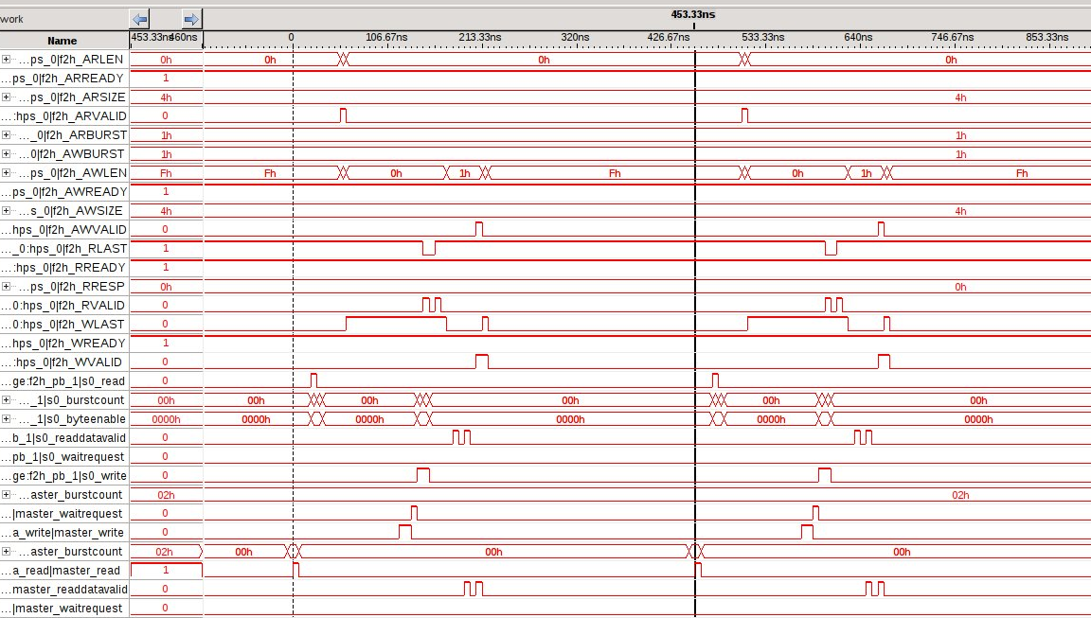
SignalTap of 32 byte DMA transfer

Slide 53
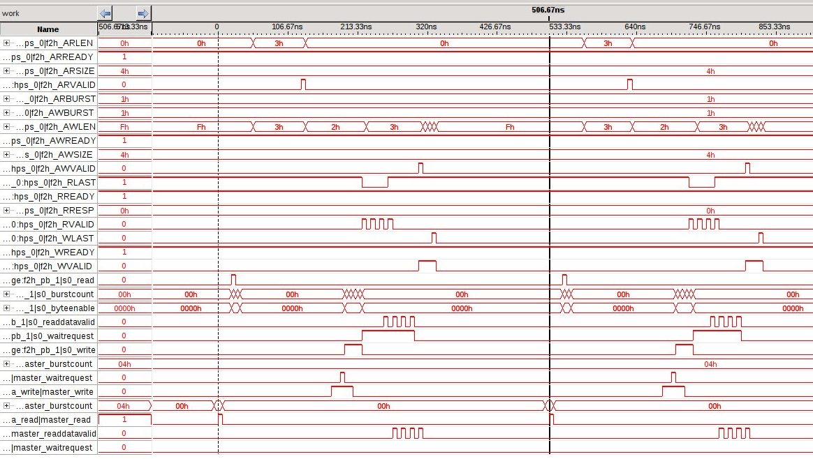
SignalTap of 64 byte DMA transfer

Slide 54
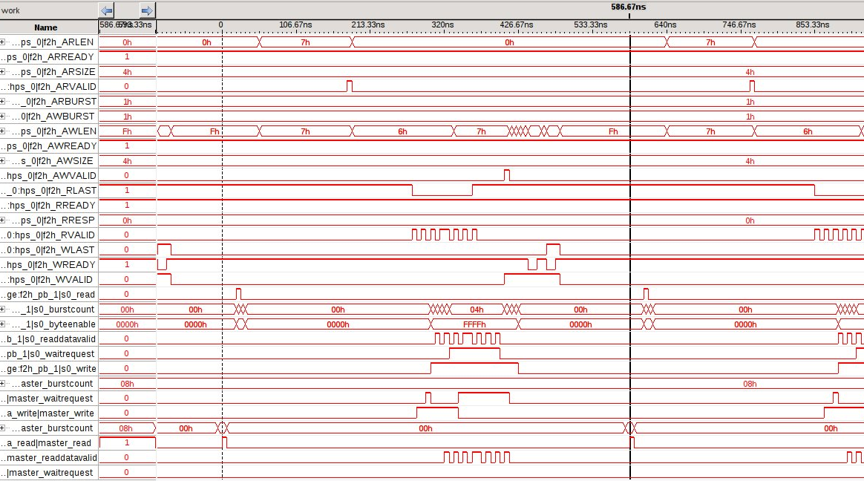
SignalTap of 128 byte DMA transfer

Slide 55
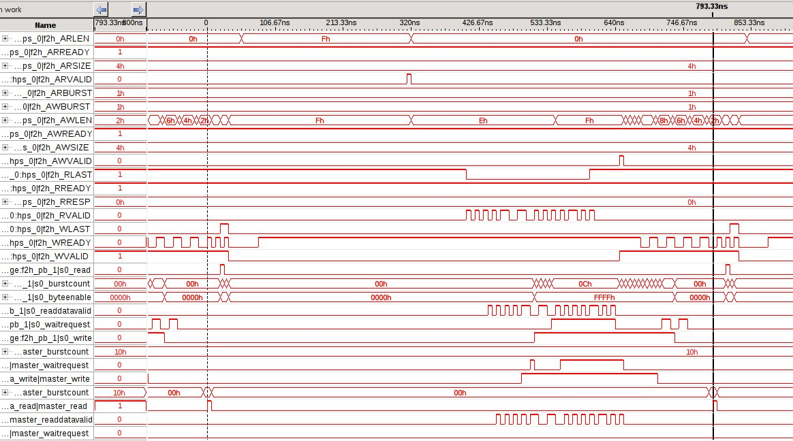
SignalTap of 256 byte DMA transfer

Slide 56
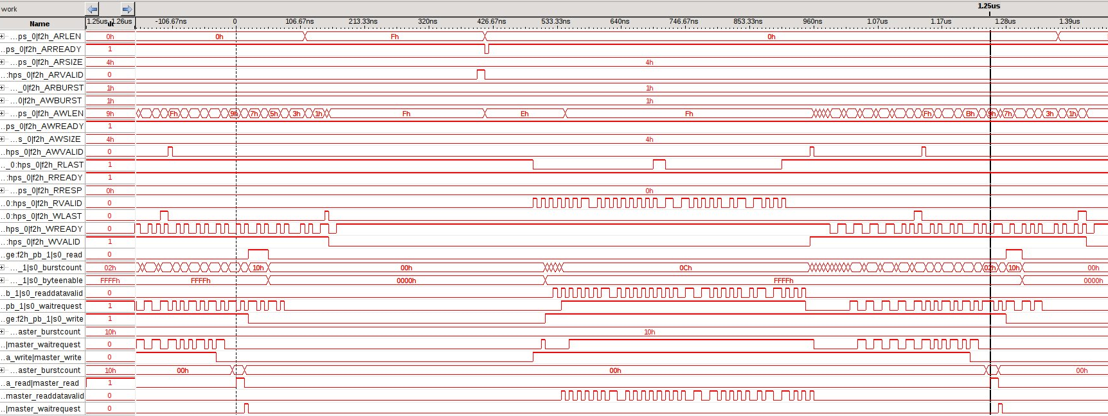
SignalTap of 512 byte DMA transfer

Slide 57
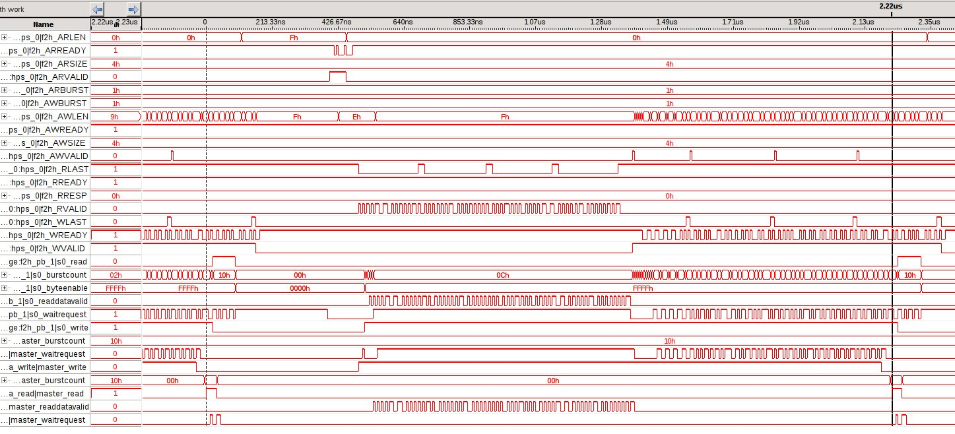
SignalTap of 1024 byte DMA transfer

Slide 58
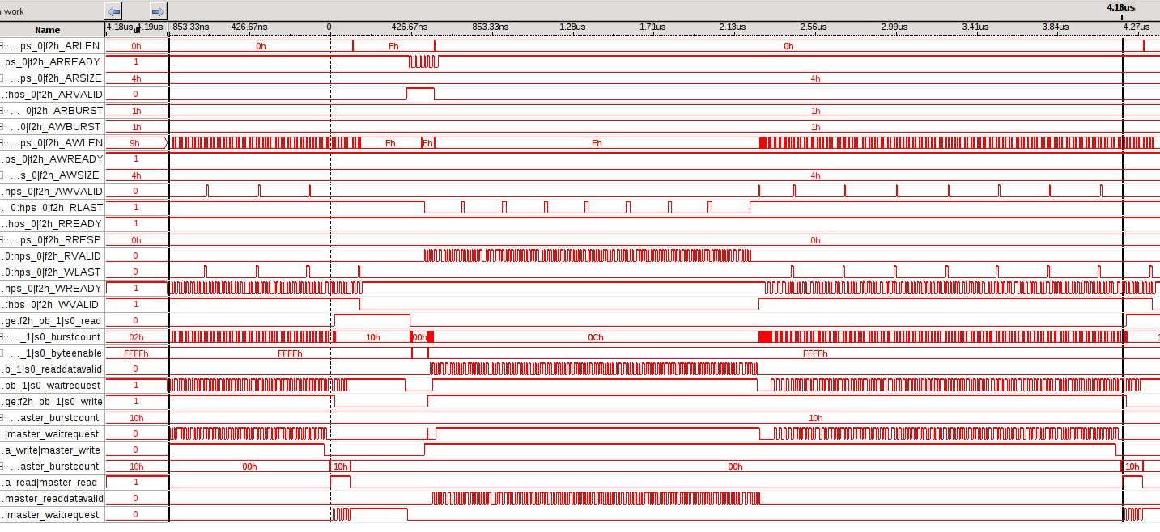
SignalTap of 2048 byte DMA transfer

